Slide 1
Verify Boot Camp Slides with new syreDesign
Nov 3, 2015

Slide 2
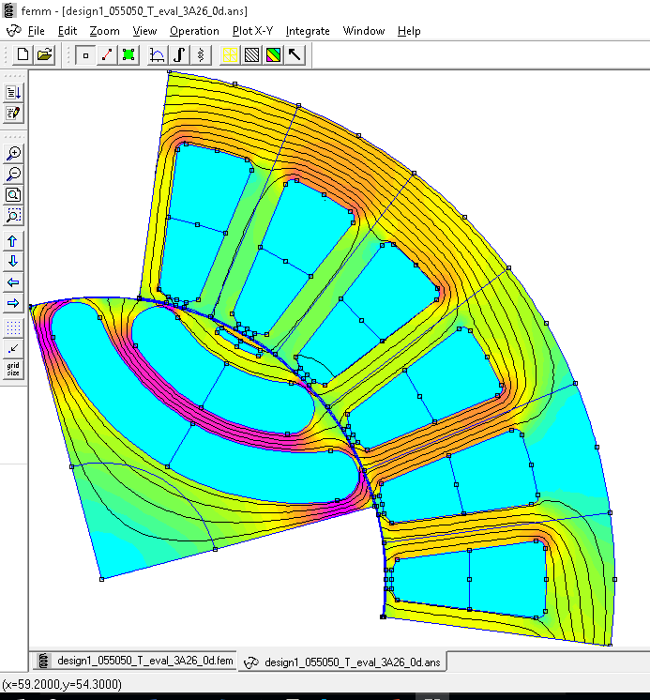
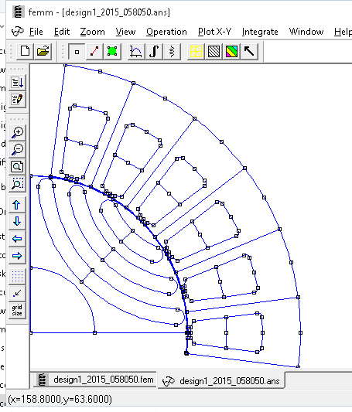
Background
syreDesign 2014 had two main defects:
Little imprecision on la (small error)
Rotor slot positions were obligated (nr = 4 * nlay, big error)
Example with nlay = 3
syreDesign 2014 assumed nr = 4 * 3 = 12,
syreDesign 2015 accepts any set of dalpha
nlay = 3 is correctly conditioned

Slide 3
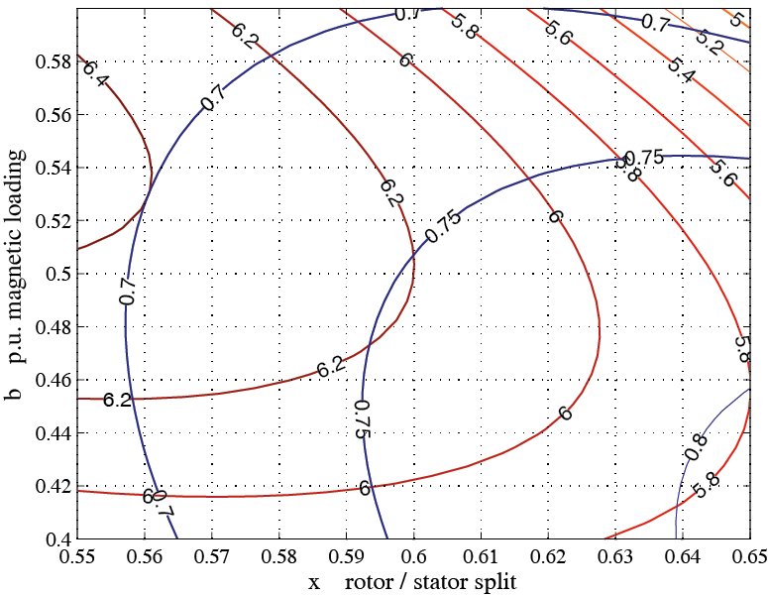
Torque and PF tradeoff
Design examples selected in 2014: today design 2 is no sense (lower torque and lower PF)
Nov 2014
Nov 2015

Slide 4
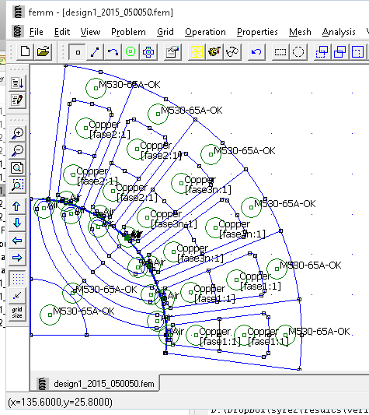
New Torque and PF tradeoff
Design examples selected in 2015: x = 0.50, b = 0.50 and x = 0.58, b = 0.50

Slide 5
FEA Validation
FEA evaluated Torque and PF for the two designs
Conclusion: the only thing in common with 2014 is that PF is underestimated by syeDesign (torque is quite ok)

